Slide 1
Office Add-Ins
- BUSINESS AND DEVELOPMENT OVERVIEW -

Slide 2
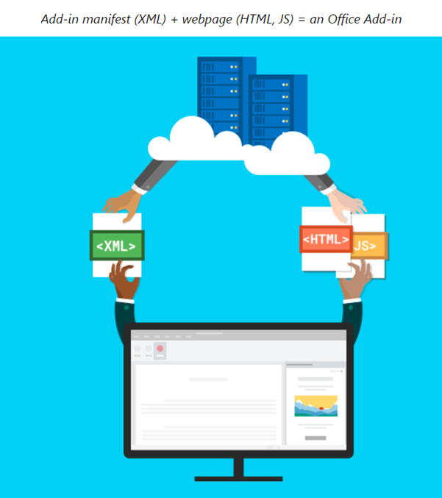
Add-In Benefits
EXTEND OFFICE FUNCTIONALITY
Interact with content in Office documents (emails, worksheets, etc.), including your data from backend systems.
CROSS-PLATFORM
Office (Web) Add-Ins solution can run in Office across multiple platforms, including Windows, Mac, iPad, and in a browser with Office 365 Online.
USE FAMILIAR DEVELOPMENT TECHNOLOGIES
Use common web technologies such as HTML, CSS, and JavaScript (including Vue JS).
SIMPLIFIED DEPLOYMENT
Web Add-ins don’t require any code to be physically installed on the user's device. Deploy to your company’s intranet, or publicly to Microsoft AppSource or the Microsoft Store.

Slide 3

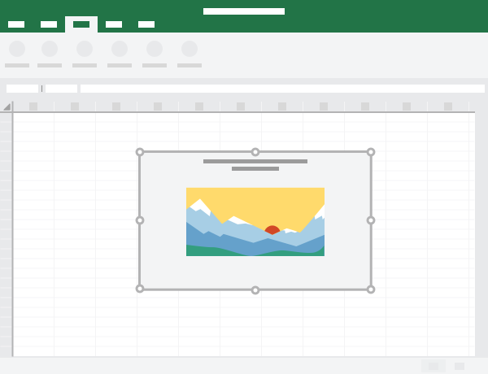

Types of Office Add-Ins
TASK PANE
You can use task panes in addition to add-in commands to enable users to interact with your solution.
MENU BUTTONS
CONTENT ADD-INS
Office Ribbon buttons can launch actions such as showing a task pane with custom HTML or executing a JavaScript function.
(Excel and PowerPoint only) With content add-ins, you can integrate rich, web-based data visualizations, media and other external content.

Slide 4
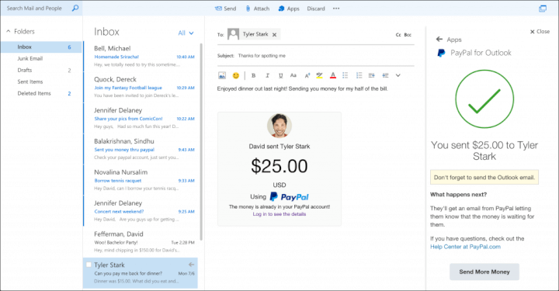
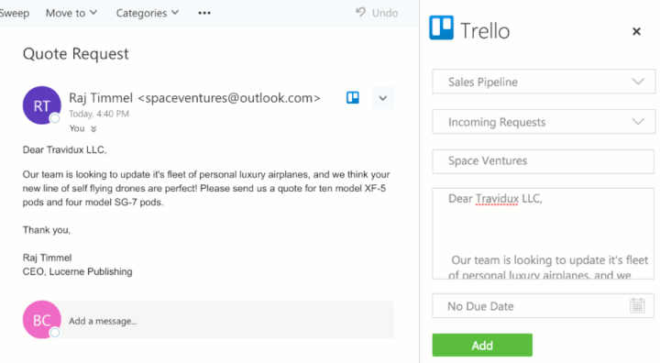
Outlook Add-In Examples
PAYPAL
TRELLO
TYPE: Task Pane
TYPE: Task Pane
Key Benefit: Send and receive money without leaving your inbox. All relevant information about your transaction flows back into your inbox.
Key Benefit: Create actionable tasks from your emails on Trello, with its Kanban styled boards and user story cards.

Slide 5
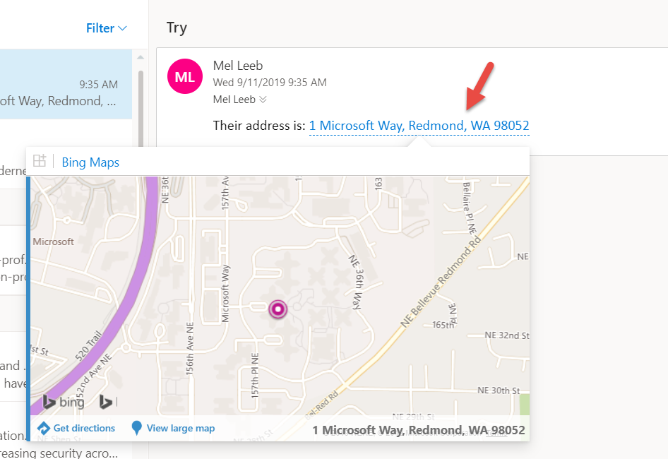
Outlook Add-Ins
AVAILABILITY
CAN BE CONTEXTUAL
Outlook add-ins are available on messages or appointments, while composing or reading.
Contextual add-ins are Outlook add-ins that activate based on text in a message or appointment. By using contextual add-ins, a user can initiate tasks related to a message without leaving the message itself, which results in an easier and richer user experience.
OBEYS SECURITY
Outlook does not activate add-ins if the current message item is protected by Information Rights Management (IRM) or encrypted in other ways, etc.

Slide 6
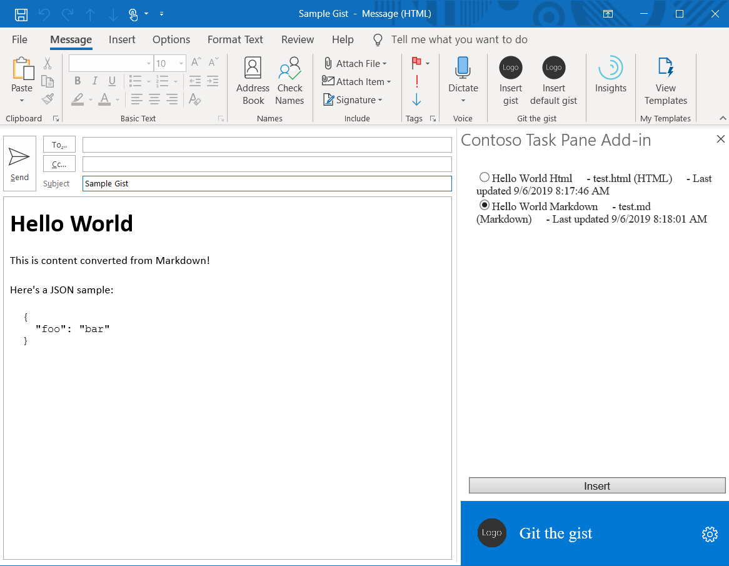
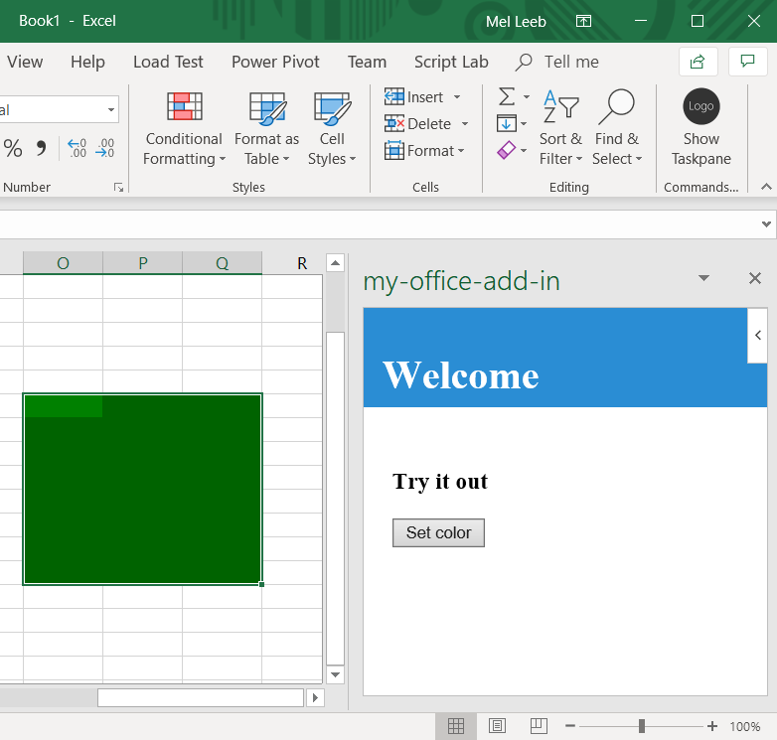
Demos
OUTLOOK – TASK PANE & COMMAND BUTTON
EXCEL – SETTING COLOR ON A SELECTED RANGE
Implements a Task pane that inserts content into the body of a message
Implements a Command button that invokes a function
Implements a first-run experience that collects information from the user and fetches data from an external service
Implements an Excel task pane add-in using Vue JS and the Excel JavaScript API
Notes:
Outlook Demo: git clone https://github.com/mleeb1/git-the-gist.git
Excel Demo: git clone https://github.com/mleeb1/my-add-in.git

Slide 7

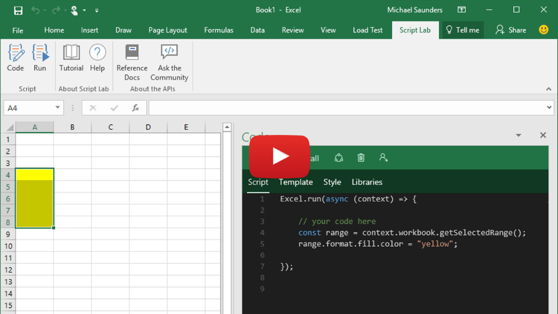
Development Notes
DEV TOOLS
Office Add-in web projects can be scaffolded using the Vue CLI and the Yeoman generator for Office Add-ins. Web app can be unit tested similar to any Vue app.
DEBUGGING
Desktop and Office Online (Web) Add-Ins can be debugged using normal F12 developer tools for Online Add-Ins or C:\Windows\SysWOW64\F12\IEChooser.exe for Desktop Add-Ins.
EXPLORING THE APIs
Office Add-In APIs include: Common and App-specific APIs (ex. – Excel JavaScript API)
Script Lab is an MS Add-in that offers a number of features to help you explore the Office JavaScript API and prototype add-in functionality. Particularly useful for Excel or Word.

